Slide 1
Will x be going to

Slide 2
Will se používá, když se rozhodneme právě teď
Be going to se používá, když mluvíme o věcech, které máme v plánu

Slide 3

Sliby - Will
I will always love you.

Slide 4

Věštění - Will
You will be rich.
She will marry a rich man.

Slide 5
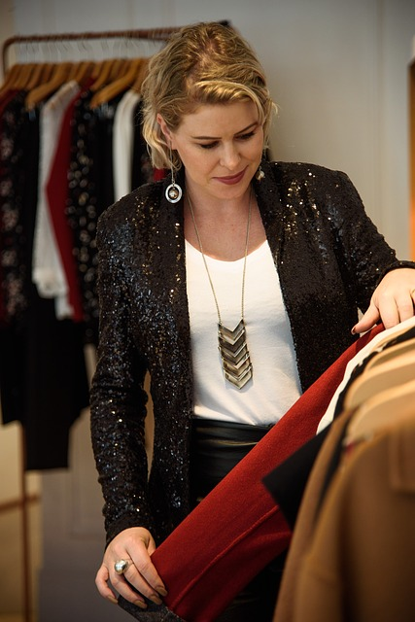
Rozhodnu se teď - Will
I will take it.
I will help you.

Slide 6

Po think - Will
I think we will go to school soon.

Slide 7

Plány – Be going to
She is going to study.

Slide 8
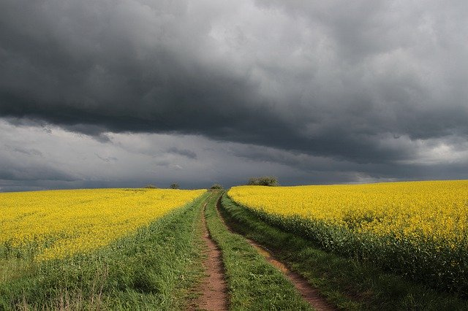
Jsme si jistí, že se to stane – Be going to
It is going to rain.

Slide 9
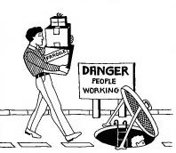
Jsme si jistí, že se to stane – Be going to
He is going to fall into the hole.

Slide 10
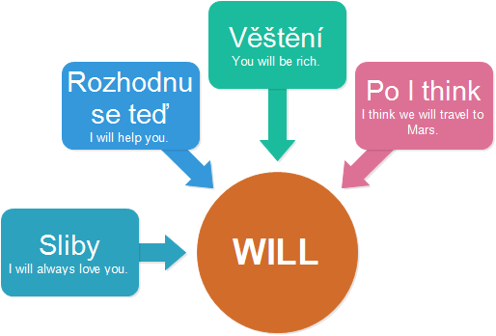

Slide 11
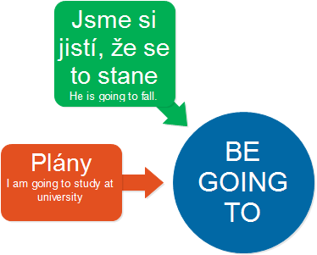

Slide 12
1. A: We don’t have any toilet paper.
B: I know. I __________________ get some from the supermarket.
2. A: There is no milk in the fridge.
B: Really? I didn't know that. You know what? I ________________ go to the shop and I ____________ get some.
3. A: Why do you want to exchange some money?
B: I __________________ visit my aunt in Ireland next month and I need euros.

Slide 13
4. A: I’m really cold.
B: I __________________ close the window.
5. A: Are you going to John’s party tonight?
B: Yes. Are you going too? I __________________ give you a lift.

Slide 14
6. A: What are your plans after you leave school?
B: I __________________ take a year off and I _____________ to travel. I have already booked the tickets. I think it ______________ be great.
7. (The phone rings)
A: I __________________ answer it!

Slide 15
8. A: Are you ready to order?
B: I can’t decide … Okay, I __________________ have the steak, please.
9. A: What are you doing tonight? Do you want to go to the cinema with me?
B: Sorry, I can´t. I __________________ visit my grandparents. I’ve already told them.

